Slide 1


LINKEDIN Content/Persona Analytics
Client: Response Informatics
M V Nikesh

Slide 2

Problem Statement: To understand the LinkedIn persona of their respective company/organization with content posted leveraging by Analytics.
LinkedIn was primary source to represent company/organization culture , services, achievements.
O P Jindal University, Response Informatics, L&T Technologies are considered to perform Analytics.
Metrics such as Interaction with audiences, Hashtags, Types of posts, Likes.
Comparisons with competitors with existing domain which technologies, tools there are using.
Recommendations for further content and marketing strategies for company/ organization for LinkedIn exposure.

Slide 3

Framework
PHASE I
Data scrapping from LinkedIn using Selenium and Web driver libraries.
Extract required features
PHASE II
Visualize results from obtained data
Inferences from the outcome
PHASE III
Perform Text mining using NLP
Analysis on the results

Slide 4
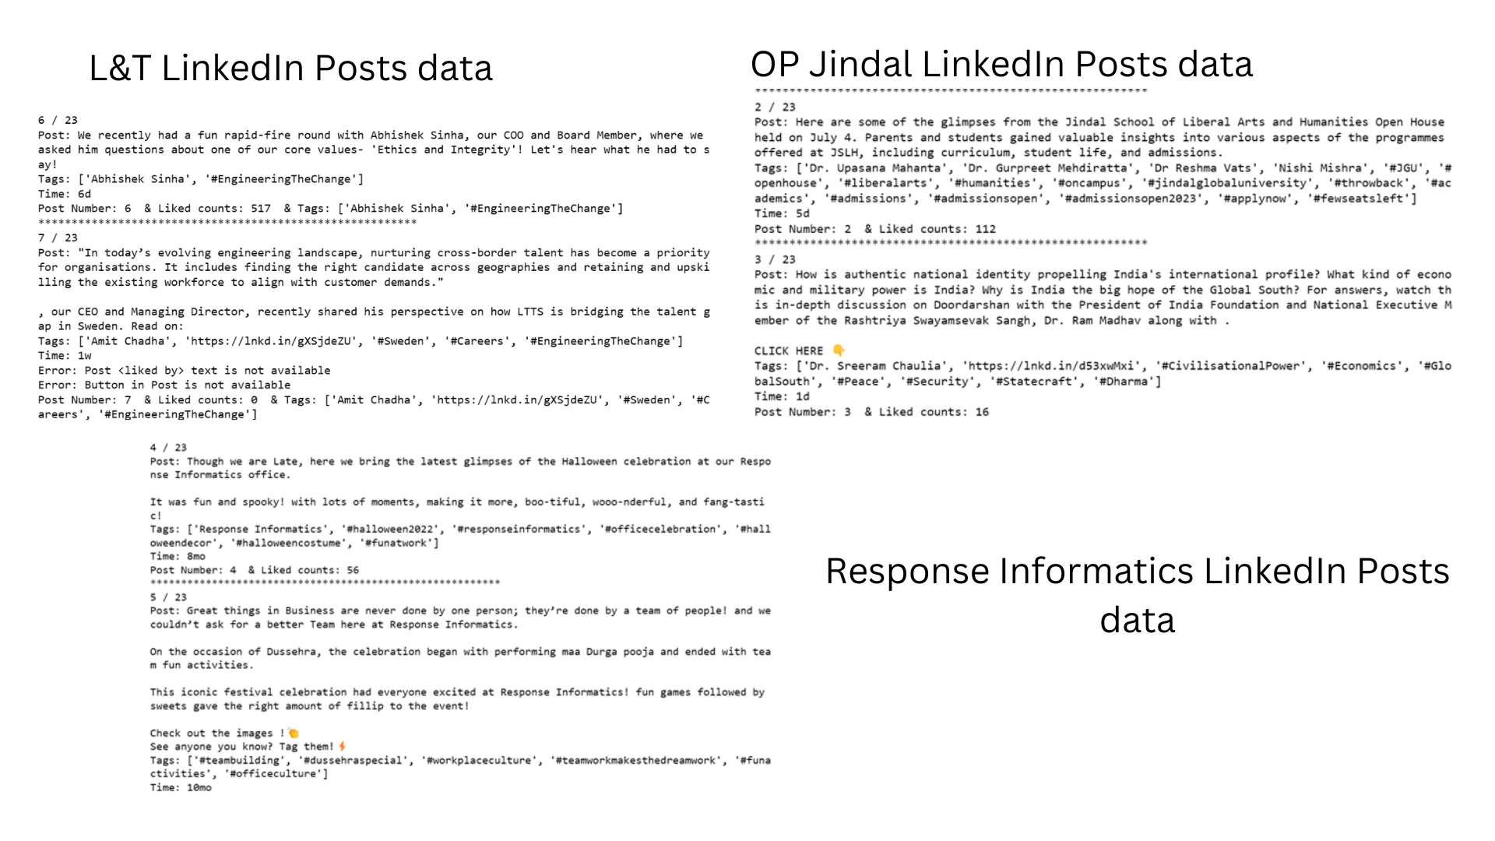
PHASE I : Web Scrapping
Using Selinium and web driver libraries log into LinkedIn account
Scrape the content with required features like
i. PostNumber,
ii. Post text,
iii. Time Posted Before,
iv. Tags in Post,
v. Number of likes,
vi. Profile links of people who liked the post

Slide 5
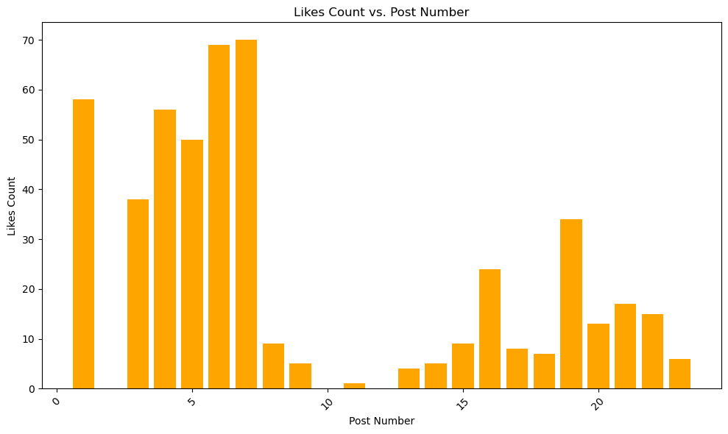
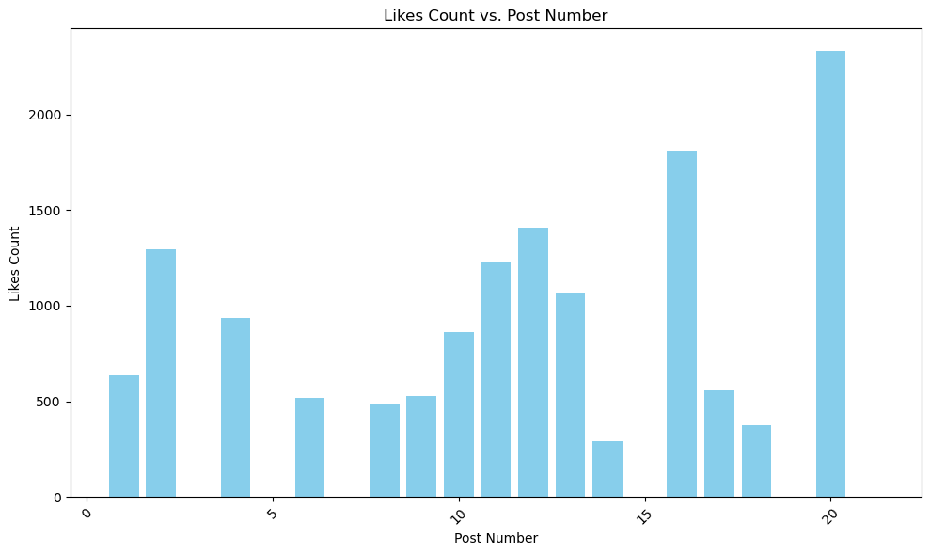
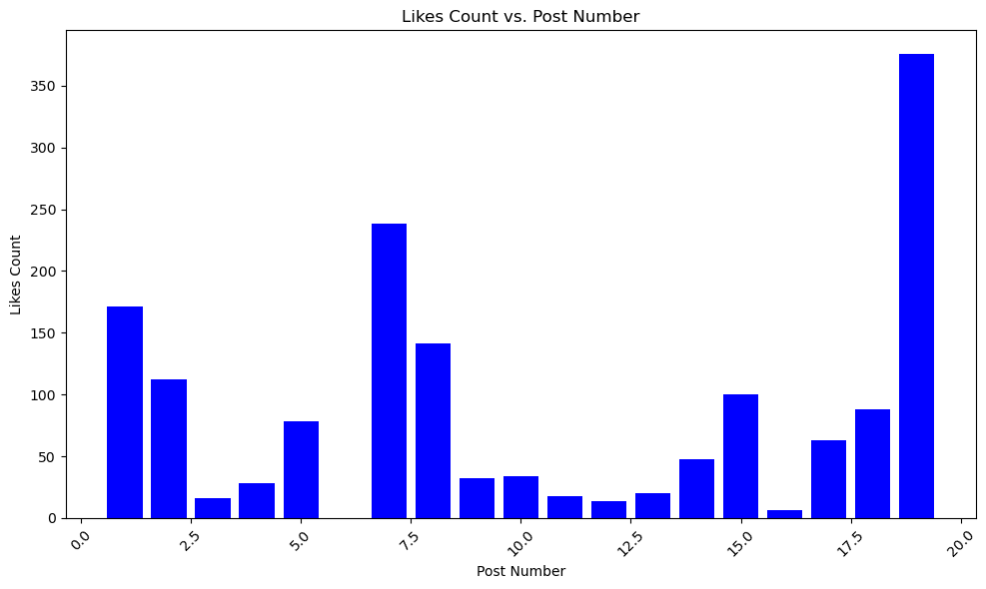
PHASE II : Visualize Results obtained
OP Jindal Post Number Vs Likes Count
Response Informatics Post Number Vs Likes Count
L&T Technologies Post Number Vs Likes Count

Slide 6
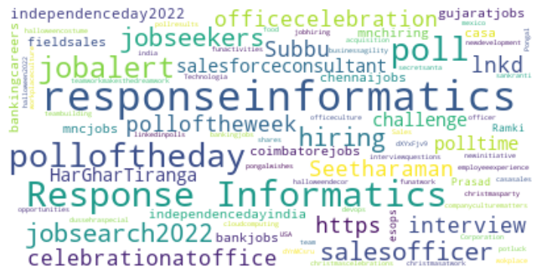
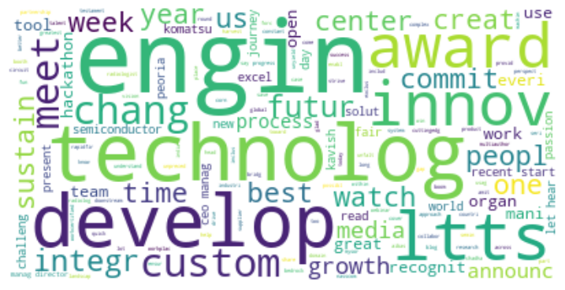
PHASE III : Text Analytics on data
Using NLTK library visualize in word cloud.
Features like Post text, Hashtags in post
Inferences on the outcomes

Slide 7

THANK YOU!

